Slide 1
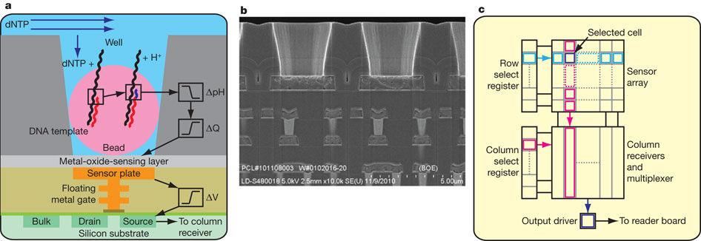

Sensor, well and chip architecture.
JM Rothberg et al. Nature 475, 348-352 (2011) doi:10.1038/nature10242

